Slide 1


Alex Huebner
14.10.2022

Slide 2

Outline
Executive Summary
Introduction
Methodology
Results
Conclusion
Appendix

Slide 3
Executive Summary
The idea of this work was to analyze and to find insights in the data of the SPACEX Falcon 9
Summary of methodologies:
Following instruments and ideas were used to collect and analyze data. Machine learning techniques were used to predict the outcome
Summary of all results:
The presentation will show the results and outcomes in different explanation ways: Visualizations of the outcome, predictive models by using machine learning techniques and different advanced algorithms and interactive dashboards

Slide 4
Introduction
Project background and context
Privat sector recently has been invested a lot of money and contributed to the Space travel industry. However, the space business is still capital intensive, technological difficult but already exciting data give an opportunity for data scientist make an impact to the industry
Problems you want to find answers
To find answers if the first stage of SpaceX Falcon will land successfully
Correlations between launch sites and success rates
To find the methods which are contributing to the landing outcomes

Slide 5

Section 1

Slide 6
Methodology
Executive Summary
Data collection methodology:
SpaceX API
Web scrap (Wikipedia)
Perform data wrangling
Using the supervised models (machine learning techniques) the outcomes was determined as 0-unsuccessful, 1 - successful
Perform exploratory data analysis (EDA) using visualization and SQL
Perform interactive visual analytics using Folium and Plotly Dash
Perform predictive analysis using classification models
Find best Hyperparameter for SVM, Classification Trees and Logistic Regression

Slide 7
Data Collection
Data sets for the analysis were collecting through different sources like Spacex API and Web scrapping. See below a SPACEX API approach and Web scraping from Wiki
API Request
Read API Response
Data Wrangling
Convert to CSV file

Slide 8
Data Collection
Web scraping method
HTTP GET Access
Installation of Beautiful Soap
Extract data to DF
Convert to CSV file
GitHub Link (code)

Slide 9
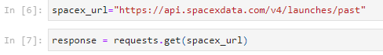
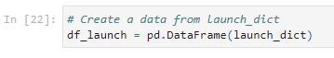
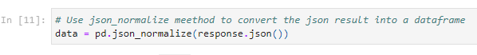
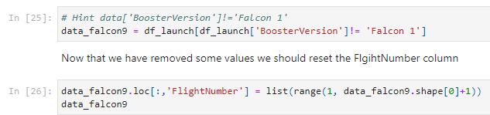
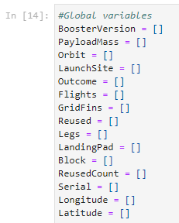
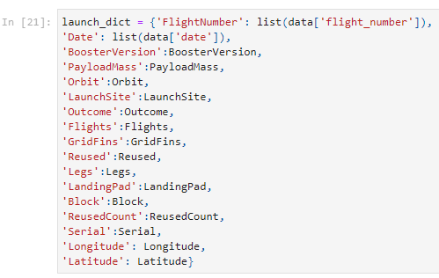
Data Collection – SpaceX API
5. Filter a dataframe and convert to CSV file
1. Getting request from API
2. Converting request to a .json file
3. Work with a custom function to clean a data
getBoosterVersion
getLaunchSite(data)
getPlayloadData(data)
getCoreData(data)
4. Assign global variable lists to dictionary to get a relevant data
GitHub Link (code)

Slide 10
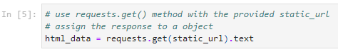
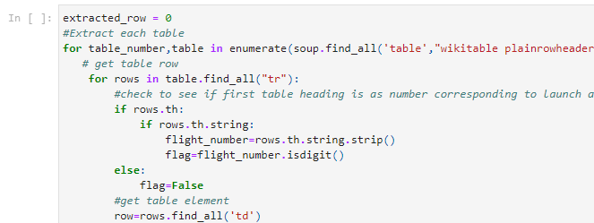
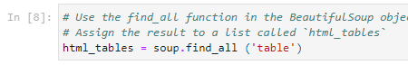
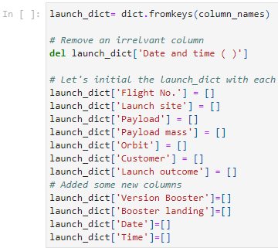
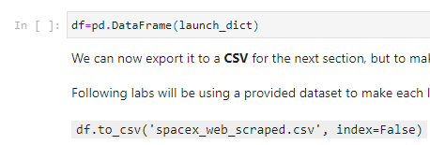
Data Collection - Scraping
5. Creation of dictionary
1. Getting request from HTML
2. Creating BeautifulSoup function
3. Looking for all tables
4. Getting column names
6. Converting launch to dataframe
GitHub Link (code)

Slide 11
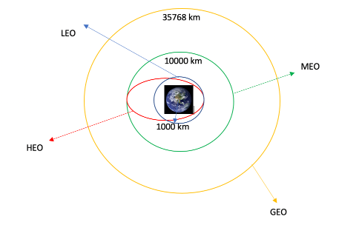
Data Wrangling
Process of Data Wrangling
Exploratory Data Analysis(EDA) using to find some patterns in the data and determine the label for training supervised models
Do calculation of launches at each site
To calculation and occurence of mission outcome per orbit type
Do calculation and occurrence of each orbit
Create a landing outcome label from Outcome column
GitHub Link (code)

Slide 12
EDA with Data Visualization
For the Exploratory data analysis, following charts were used to gain more insights of the dataset and get a better outcome:
1. Scatter Graphs
the relationship between Flight Number and Launch Site
the relationship between Payload and Launch Site
the relationship between FlightNumber and Orbit type
the relationship between Payload and Orbit type
2. Bar Graph
the relationship between success rate of each orbit type
Success Rate of tach trbit type
3. Line Graph
the launch success yearly trend
GitHub Link (code)

Slide 13
EDA with SQL
By analyzing the SpaceX data set following task and questions were used to get better understanding the data
Display the names of the unique launch sites in the space mission
Display 5 records where launch sites begin with the string 'CCA'
Display the total payload mass carried by boosters launched by NASA (CRS)
Display average payload mass carried by booster version F9 v1.1
List the date when the first successful landing outcome in ground pad was acheived.
List the names of the boosters which have success in drone ship and have payload mass greater than 4000 but less than 6000
List the total number of successful and failure mission outcomes
List the names of the booster_versions which have carried the maximum payload mass. Use a subquery:
List the failed landing_outcomes in drone ship, their booster versions, and launch site names for in year 2015
Rank the count of landing outcomes (such as Failure (drone ship) or Success (ground pad)) between the date 2010-06-04 and 2017-03-20, in descending order
GitHub Link (code)

Slide 14
Build an Interactive Map with Folium
Interactive Map with Folium is helpful if you need to analyse geospatial data to perform and understand the impact of location close to the rocket launch
The following dataset with the name spacex_launch_geo.csv is an augmented dataset with latitude and longitude added for each site.
Dataframe launch_outcomes to classes 0 and 1 with Green and Red markers on the map in a MarkerCluster was added
Calculated distances between a launch site to its proximities or to various landmarks to find several trends and patterns.
The Interactive Map with Folium helped the project to answer following questions:
Are launch sites in close proximity to railways? YES
Are launch sites in close proximity to highways? YES
Are launch sites in close proximity to coastline? YES
Do launch sites keep certain distance away from cities? YES
GitHub Link (code)

Slide 15
Build a Dashboard with Plotly Dash
PIE CHART – showing the total success for all sites/by certain launch site
Percentage of success in relation to launch site
SCATTER GRAPH – showing a correlation between Payload and success for all sites/by certain launch site
It shows the relationship between success rate and booster version category
It is a good method to show a non-linear pattern
The range of data flow, i.e. maximum and minimum value would be determined
Dashboard was created to solve following tasks:
Which site has the largest successful launches ? Result: KSC LC-39A with 10
Which site has the highest launch success rate? Result: KSC LC-39A with 76.9% success
Which payload range has the highest launch success rate? Result: 2000-5000 KG
GitHub Link (code)

Slide 16
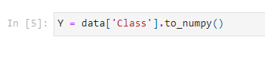
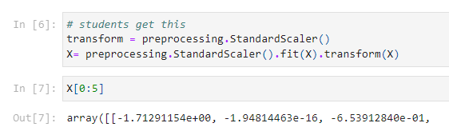
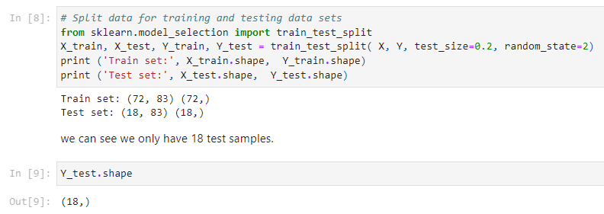
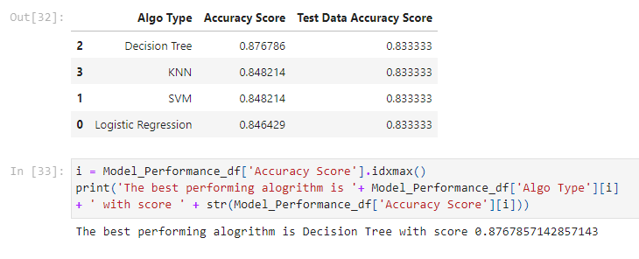
Predictive Analysis (Classification)
Create a NumPy array from the column CLASS in DATA
Standardize the data in
Train_Test_Split data into training and test data sets
Create a logistic regression
Calculate the accuracy on the test data
Create a support vector machine
Calculate the accuracy on the test data
Create a decision tree
Calculate the accuracy of decision tree algorithm
Create a k nearest neighbors
Find the algorithm performs best
GitHub Link (code)

Slide 17
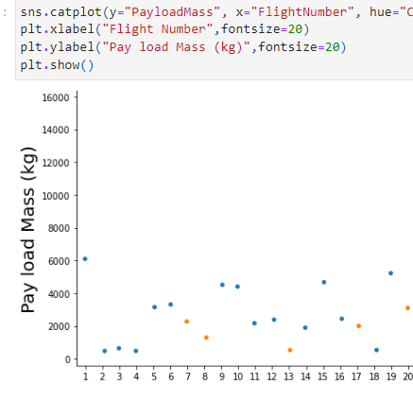
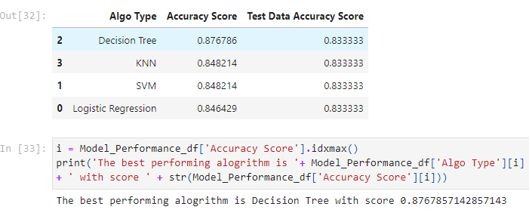
Results
Exploratory data analysis results
Interactive analytics demo in screenshots
Predictive analysis results

Slide 18

Section 2

Slide 19
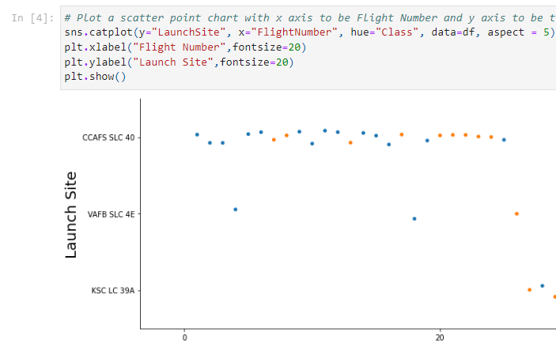
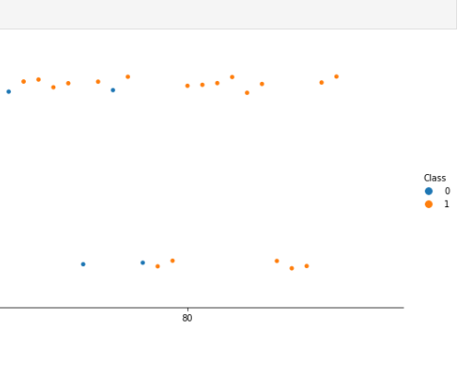
Flight Number vs. Launch Site
Conclusion:
With higher flights numbers the success rate for the rocket is increasing
For launch site KSC LC 39 A it takes at least 30 launches before a first successful launch

Slide 20
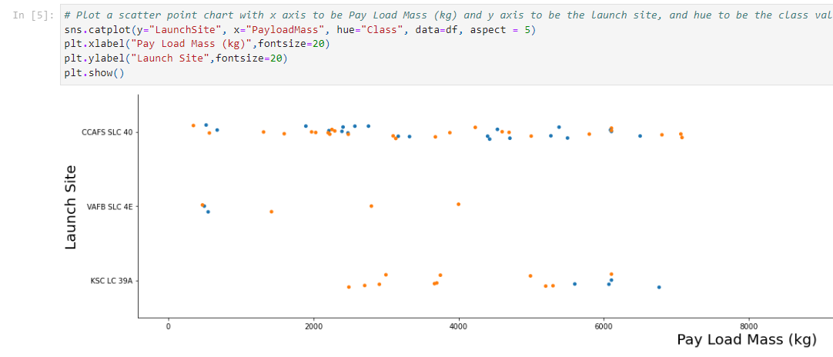
Payload vs. Launch Site
Observation if there is any relationship between launch sites and their payload mass:
for launch site, there are no rockets launched for payload greater than 10 000KG
no correlation between launch site and payload mass

Slide 21
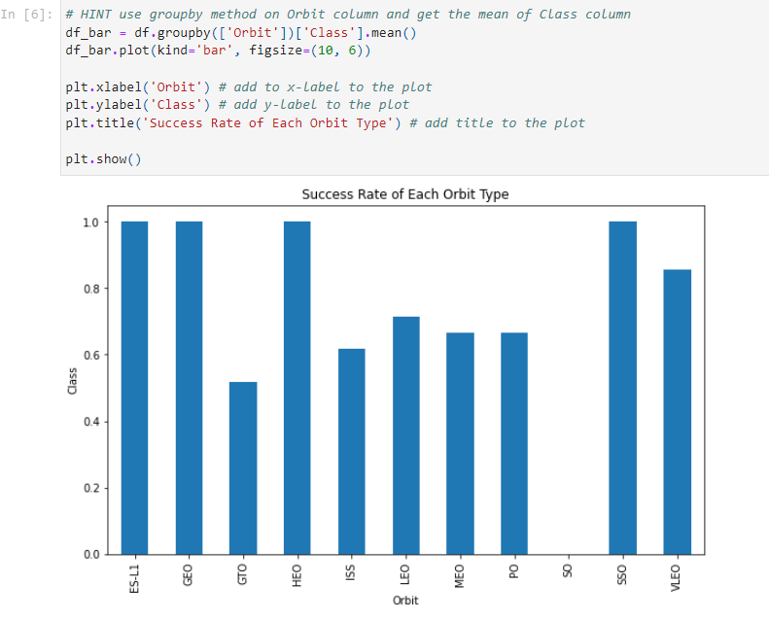
Success Rate vs. Orbit Type
ES-L1, GEO, HEO, SSO has highest success rate
GTO orbit has the lowest success rate

Slide 22
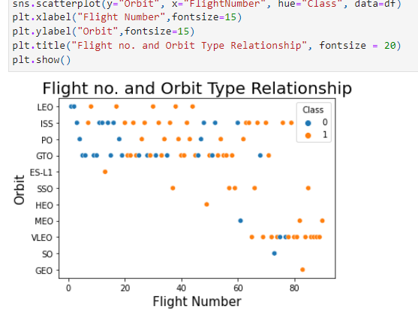
Flight Number vs. Orbit Type
No relationship between flight number and orbit for GTO
For most orbits LEO, ISS, PO, VLEO successful landing rates appear to increase with flight number

Slide 23
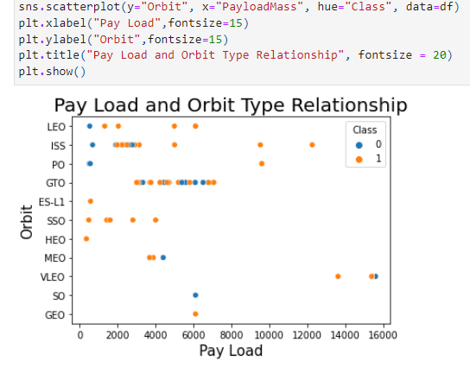
Payload vs. Orbit Type
GEO orbit no relationship between payload and orbit for successful landing
Successful landing rates increasing with pay load features for following orbits LEO, ISS, PO, SSO

Slide 24
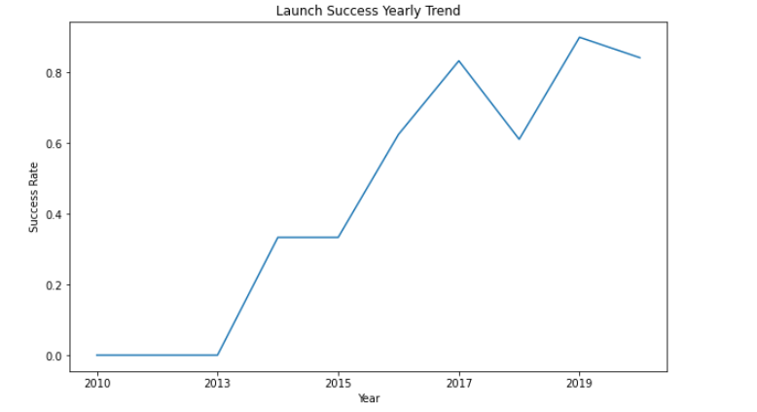
Launch Success Yearly Trend
The success rate was since 2013 and 2020 about 80% kept significantly increasing
But success rate decreases between 2017 and 2018, however 2019 and 2020 as well

Slide 25
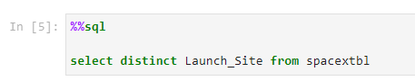
All Launch Site Names
There are four unique launch sites
Unique Launch Sites
launch_site
CCAFS LC-40
CCAFS SLC-40
KSC LC-39A
VAFB SLC-4E

Slide 26
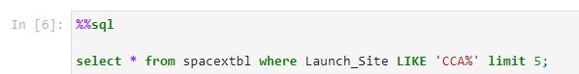
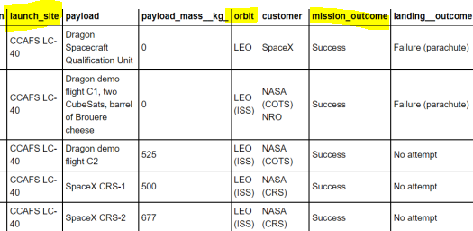
Launch Site Names Begin with 'CCA'
Query:
Description:
Select top limit five, returns only five records
`LIKE` query and format `CCA%` returns where `Launch_Site` column beginn with CCA

Slide 27
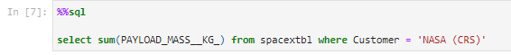
Total Payload Mass
QUERY Explanation
Using the function `sum` adds column PAYLOAD_MASS_KG
The WHERE function filters the dataset `NASA (CRS)
SQL QUERY
Outcome
45596

Slide 28
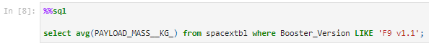
Average Payload Mass by F9 v1.1
QUERY Explanation
`avg` function returns the average of payload in the column PAYLOAD_MASS_KG
SQL QUERY
Outcome
2928

Slide 29
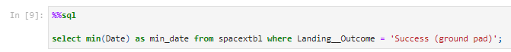
First Successful Ground Landing Date
QUERY Explanation
`min`(Data) functions works by selecting the minimum date in the column DATE
SQL QUERY
Outcome
Min_date
2015-12-22

Slide 30
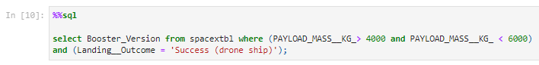
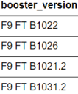
Successful Drone Ship Landing with Payload between 4000 and 6000
SQL QUERY
QUERY Explanation
Using only Booster_Version
Where function filters the dataset from Landing_Outcome = Success drone ship) and both conditions are true
Outcome

Slide 31
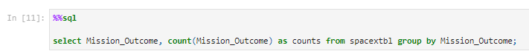
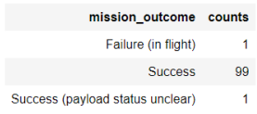
Total Number of Successful and Failure Mission Outcomes
QUERY Explanation
Group by function arranges data in a column group
Mission_Outcome are grouped in column `counts`
SQL QUERY
Outcome

Slide 32
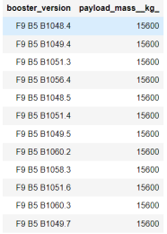
Boosters Carried Maximum Payload
QUERY Explanation
By using the function `max` the query search the maximum payload mass
The function booster_version returns mass maximum with value of 15600
SQL Query
Outcome

Slide 33
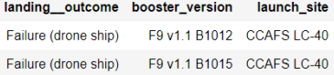
2015 Launch Records
SQL Query
Query Explanation
The `year` function extracts a year from column `Date`
The function or query `landing outcome`, `booster version` and `launch site` showing where the launding outcome is failed during the period in 2015
Outcome

Slide 34
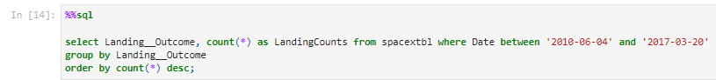
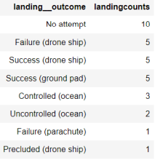
Rank Landing Outcomes Between 2010-06-04 and 2017-03-20
Query
Outcome
Query explanation
Count - function counts records in column
Group by – arranges the data into groups
AND - conditions
Order by – arranges in descending order

Slide 35

Section 3

Slide 36
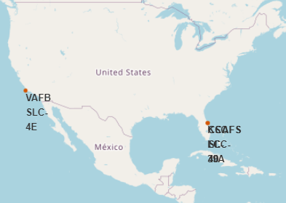
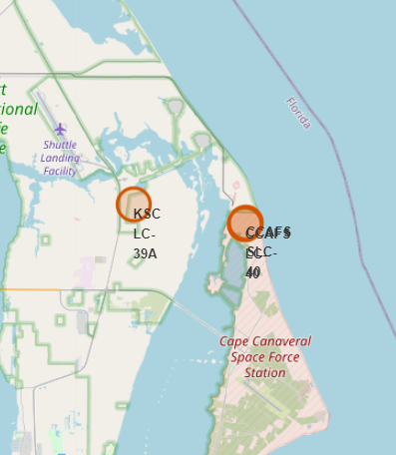
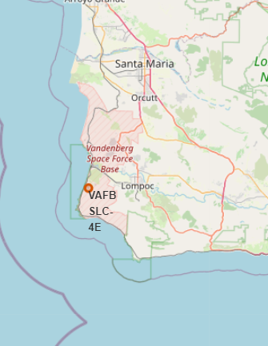
SITE_MAP
Figures shows the Global map where Falcon 9 launch sites are located in USA. By the way all launch sites are close to the coast
Another Figures shows zoomed the launch sites:
VAFB SLC-4E
CCAFS LC-40
KSC LC-39A
CCAFS SLC-40

Slide 37
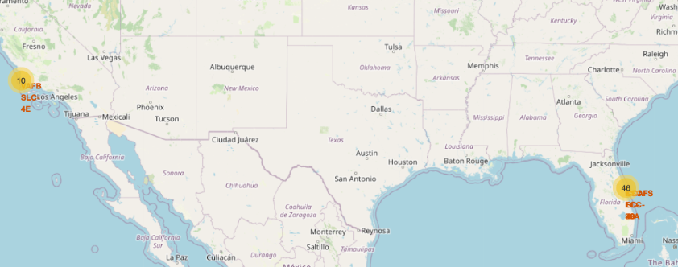
All launch sites in USA
All launch sites are in USA, Florida and California

Slide 38
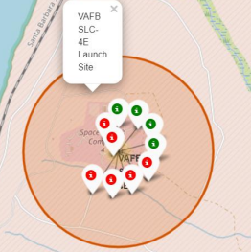
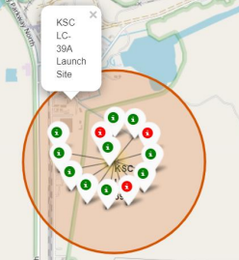
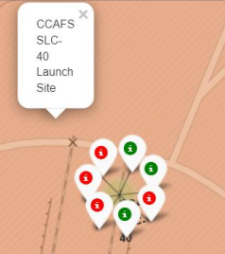
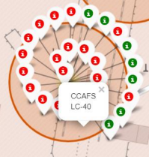
SpaceX Falcon9-Success and Failed launch sites labelled markers
Figure 1
Shows successful (green marker) and failed (red markers) launches of the VAFB SLC-4E launch site CALIFORNIA
Figure 2
Shows successful (green marker) and failed (red markers) launches of the KSC-LC-39A launch site FLORIDA
Figure 3
Shows successful (green marker) and failed (red markers) launches of the CCAFS-SLC-40 launch site FLORIDA
Figure 4
Shows successful (green marker) and failed (red markers) launches of the CCAFS LC-40 launch site FLORIDA

Slide 39

Section 4

Slide 40
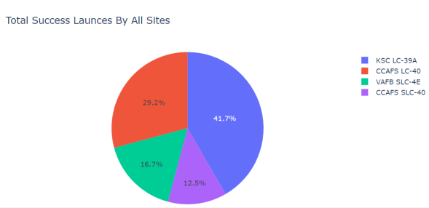
Dashboard showing the success of each launch site
Results:
KSC LC-39A has a highest succesful rate by all sites

Slide 41
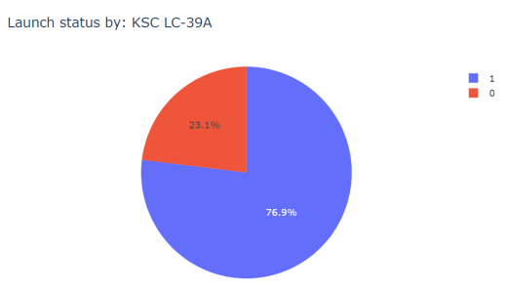
Dashboard – Launch site with a highest launch success ratio
KSC LC-39A has a 76.9% success rate. However the failure rate is by 23.1%

Slide 42
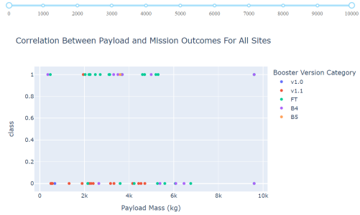

Payload versus Launch Outcome Scatter Plot for all sites
Results:
In the payload from 2000 between 5500 range are most successful launches

Slide 43

Section 5

Slide 44


Classification Accuracy
Results:
Decision Tree machine learning algorithm has a best fit to our model accuracy score with a value of 0.87

Slide 45

Confusion Matrix
Results:
By analyzing the confusion matrix we can see that classifier has been made 18 predictions
The confusion matrix has been build for models
Three situations has been predicted N0 for landing and TRUE positive
Three situations has been predicted YES for landing, however they could not land successfully

Slide 46
Conclusions
The best performing algorithm Decision Tree with score 0.876 (87.5%)
Lunch sites are located for a purpose close to the coast areas (avoiding public areas)
Launch success rate increased during the 2013 to 2020 period by 80%
Orbits ES-L1, GEO, HEO, SSO are being the highest success rates, however orbit GTO has the lowest success rate

Slide 47
Appendix
IBM Watson Studio Notebook
Python code

Slide 48


